Slide 1
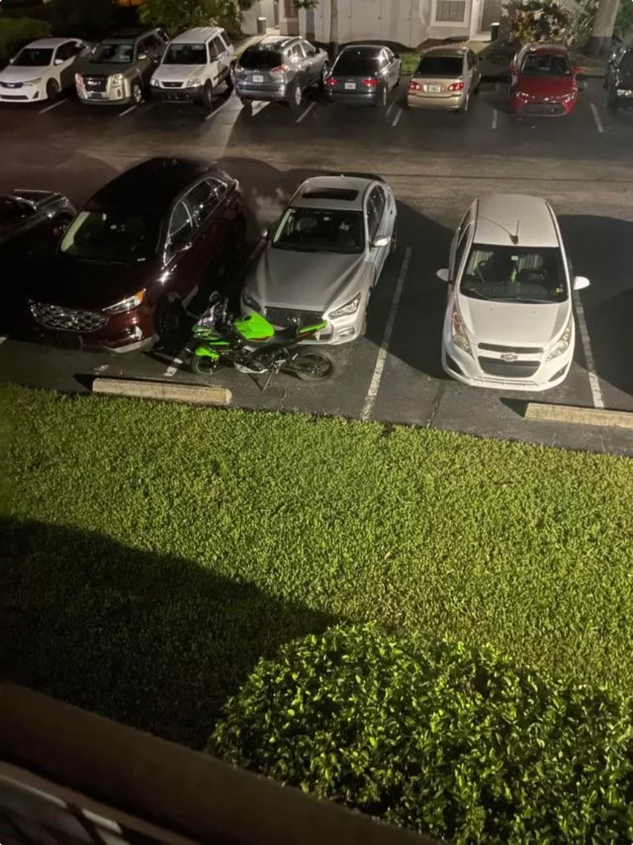
PROJECT TITLE
Parking Lot Management System
Using Core Java & Object-Oriented Programming Concepts
Project Details
Subject: Object Oriented Programming with Java
Project ID: RU-100-01-00012
Student Information
Name: Harsh Vardhan
ERP ID: RU-25-10556
College: Rungta International Skills University
Department: Computer Science & Engineering
Academics Year: 2025-29 (First Year)

Slide 2
INTRODUCTION
SMART MOBILITY
Introduction
Addressing the growing demand for smart and efficient urban mobility solutions.
Problems in Traditional Systems
Why Automation Matters
Manual parking slot management
Efficient slot allocation
Time-consuming vehicle tracking
Automated fee calculation
Difficulty in calculating parking fees
Lack of real-time slot availability
Real-time availability tracking
Human errors and inefficiency
Poor customer experience
Reduced manual workload
Improved accuracy
Better customer satisfaction

Slide 3
OBJECTIVES
SCOPE
SMART PARKING
Objectives & Scope
Key goals and application areas for the smart parking system.
Objectives
Scope
Manage parking slots efficiently
Suitable for malls and shopping centers
Assign parking spaces automatically
Applicable to office buildings and corporate parks
Track vehicle entry and exit
Calculate parking fees accurately
Ideal for colleges and educational institutions
Reduce manual work and human errors
Apply OOP concepts in Java implementation
Effective for small to medium parking areas
Can be expanded for larger applications
Scalable architecture for future enhancements

Slide 4




SYSTEM REQUIREMENTS
TECHNOLOGIES
SMART PARKING
System Requirements
& Technologies
Essential hardware, software, and core technologies.
Hardware Requirements
Software Requirements
Technologies Used
Java JDK 8 or higher
Core Java
1
Required for compiling and running the application.
Object-oriented foundation for the full system.
4GB RAM minimum
Code Editor / IDE
OOP Concepts
2
VS Code, Eclipse, or IntelliJ IDEA for development.
Encapsulation, inheritance, and polymorphism.
Operating System
Collections
Intel i5 or equivalent
3
Compatible with Windows, Linux, or macOS environments.
ArrayList and the Collections Framework for data handling.
Git Version Control
File I/O
4
Used for source control and project collaboration.
Persistent storage and retrieval of parking data.
500MB free storage
Exception Handling
Improves stability and error management.
1024×768 display or higher

Slide 5

WORKFLOW
PROCESS FLOW
SMART PARKING
System Workflow & Process Flow
Simple, sequential steps from start to finish.
Process Tasks
Start
Display Menu
User Chooses
Store Info
The workflow moves step by step through a continuous cycle, returning users to the main menu whenever they choose to continue.

Slide 6
CLASS DIAGRAM
OOP CONCEPTS
MINIMAL DESIGN
Class Diagram & OOP Concepts
Minimalist class structure and core OOP principles.
Class Structure (UML-style)
OOP Concepts Explained
Vehicle Class:
Encapsulation: Data hiding with private variables and public methods
Abstraction: Hiding complex implementation details
- vehicleId: String
- vehicleName: String
- entryTime: LocalDateTime
- exitTime: LocalDateTime
+ getVehicleDetails()
+ calculateDuration()
Inheritance: Extending classes for code reuse
Polymorphism: Method overriding and overloading
ParkingLot Class:
- totalSlots: int
- availableSlots: int
- vehicles: ArrayList<Vehicle>
+ parkVehicle()
+ removeVehicle()
+ searchVehicle()
+ getAvailableSlots()
Main Class:
- displayMenu()
- handleUserInput()
- main()

Slide 7
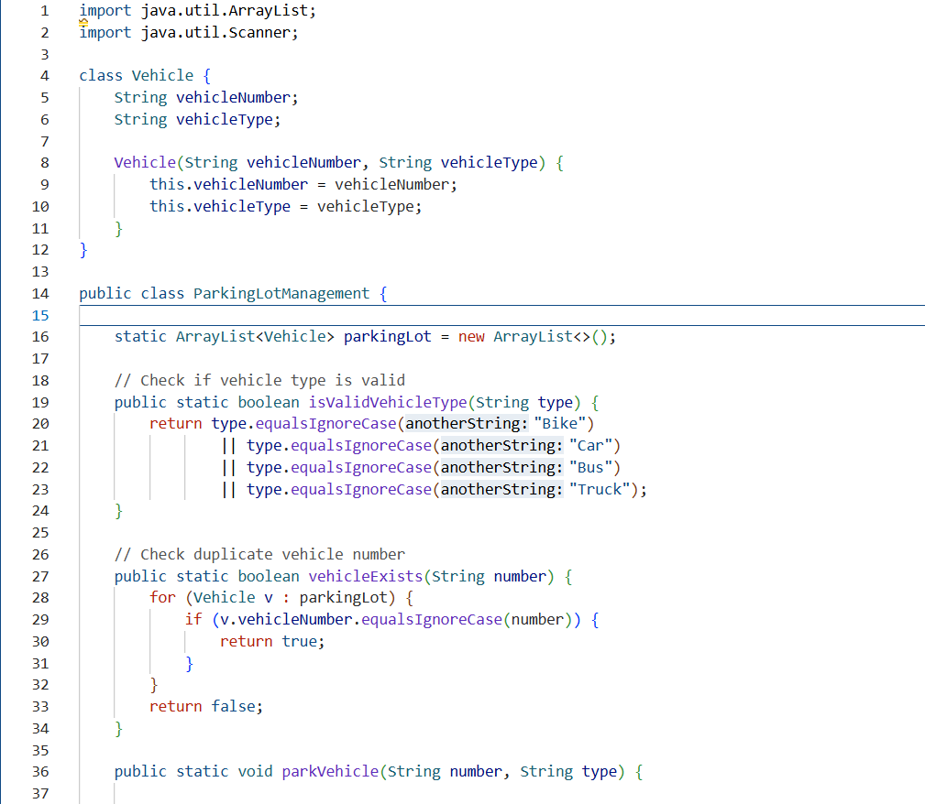
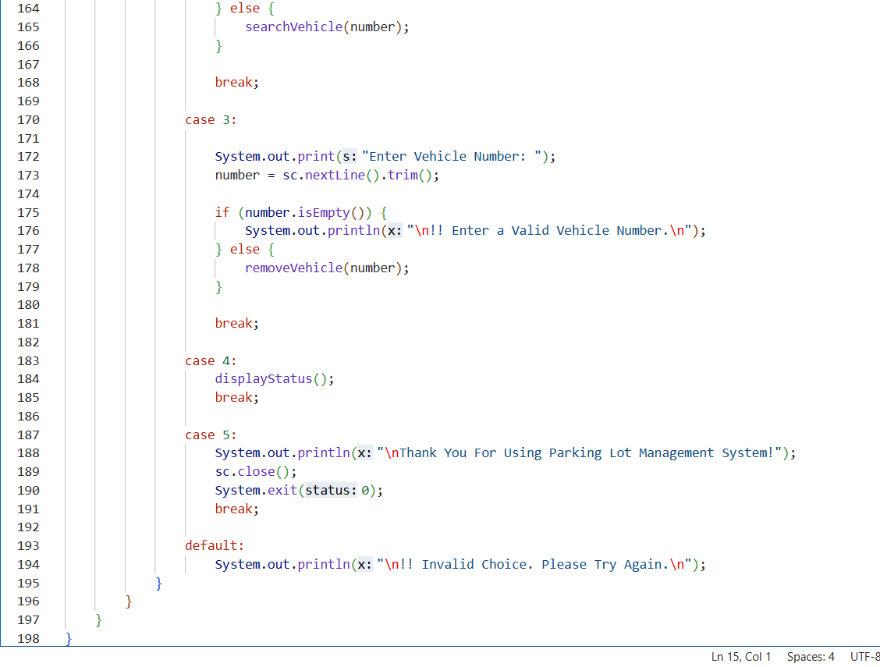
PROJECT SCREENSHOT

Slide 8
CONCLUSION
FUTURE SCOPE
PROJECT SUMMARY
Conclusion &
Future Scope
A polished summary of today’s results and the next wave of improvements.
This final section highlights the parking system’s current strengths, then previews the features that can make it even smarter, faster, and more connected in the future.
Key Achievements
Future Enhancements
Streamlined parking operations
Reduced manual effort
Online booking system
Automated repetitive steps to save time and minimize human error.
Enable advance reservations for better convenience and planning.
Organized the core workflow for parking, searching, status checks, and vehicle removal.
QR code entry
Improved slot tracking
Applied Java OOP concepts
Speed up access with contactless verification at entry and exit.
Made space availability easier to monitor and manage in real time.
Used an object-oriented structure that supports clean code and maintainability.
Payment gateway integration
Support secure digital payments and faster checkout.
Created a user-friendly interface
Built a scalable foundation
Mobile application
Designed simple screens that make common operations quick and intuitive.
Prepared the project for future features, integrations, and growth.
Extend system access to phones for anytime, anywhere use.
Real-time monitoring
Provide live visibility into parking availability and status.
Analytics and notifications
Add reports, insights, and alerts to improve decision-making.

Slide 9
Thank You

